Slide 1
Recent Advances in Planar thin-film stacks
Reporter:Zhengji Wen
2019.03.06

Slide 2
Outline
Perfect absorption and Tamm Plasmons
Brewster effect when approaching points of degeneracy
Angular dispersions in mutilayer stacks
Limiting Optical Diodes and Nonreciprocity
Color Reflector
Goos-Hänchen shift and Biosensing application
Dual-band infrared imaging
EMT for Bianisotropic Photonic Metamaterials

Slide 3
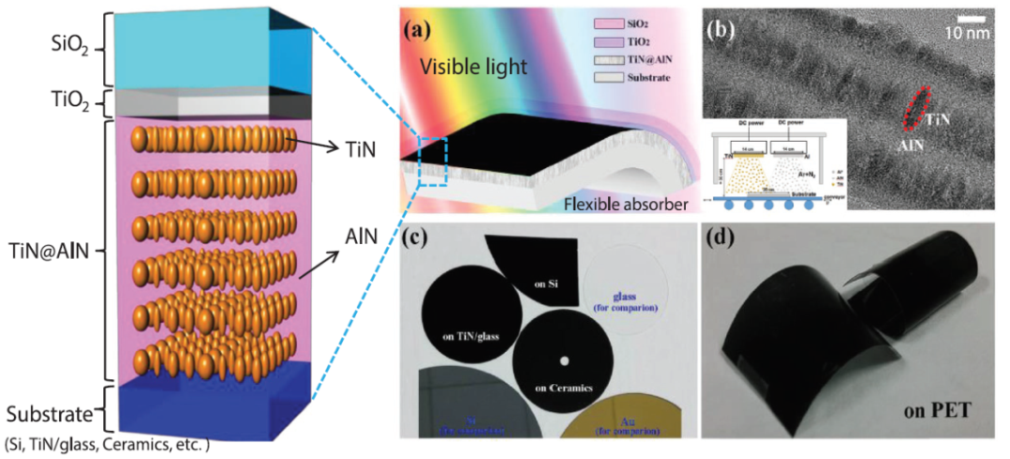
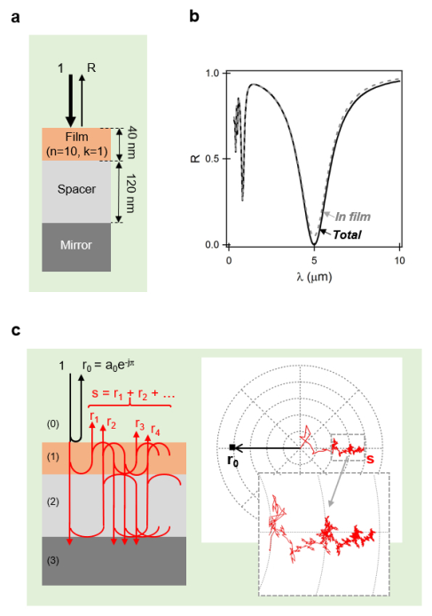

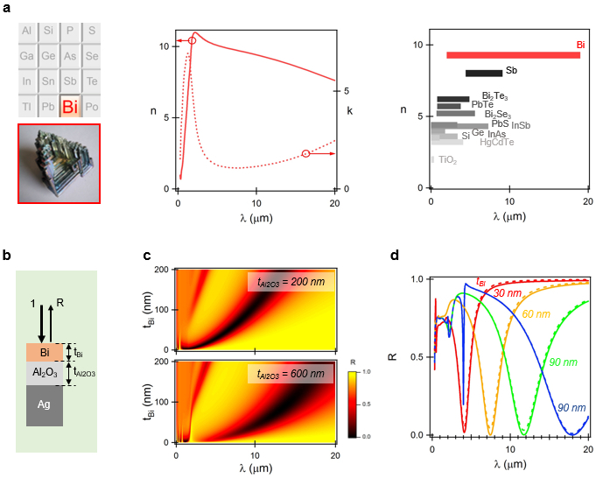
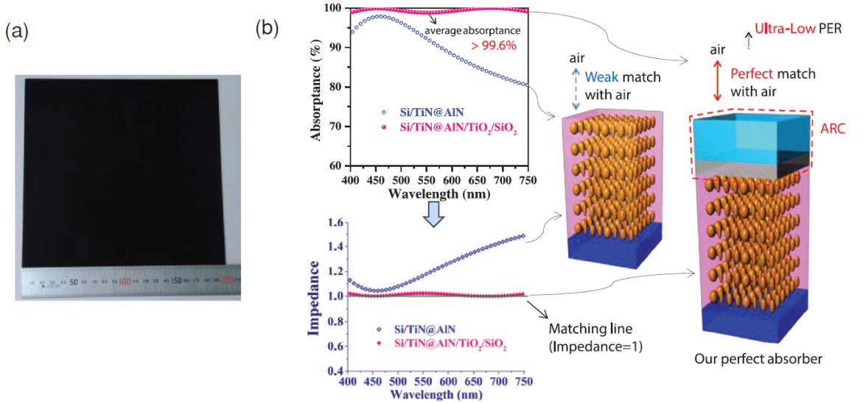
Perfect absorption
Fractal phasor resonant cavity for infrared perfect absorption in a sub - λ/100 nanofilm
Large-Area Low-Cost Dielectric Perfect Absorber
Optics Express 26, 34043-34059 (2018)
Adv. Optical Mater. 1801596 (2019)

Slide 4
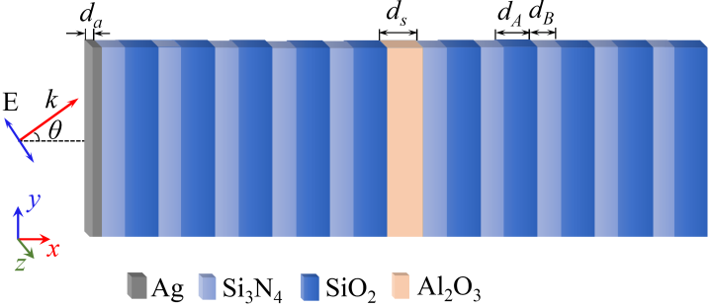
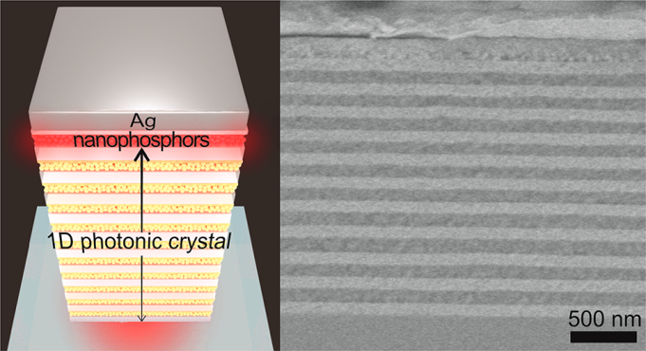
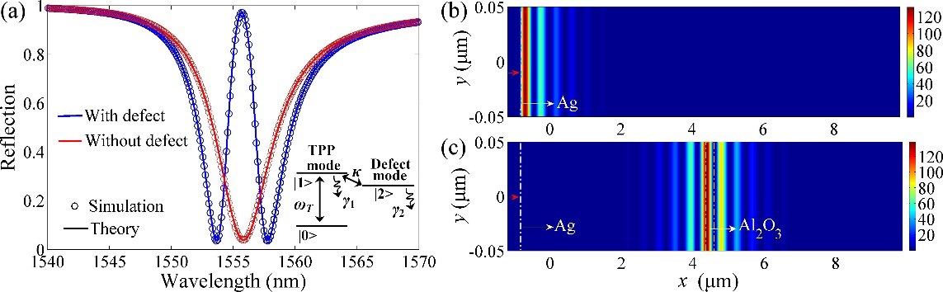
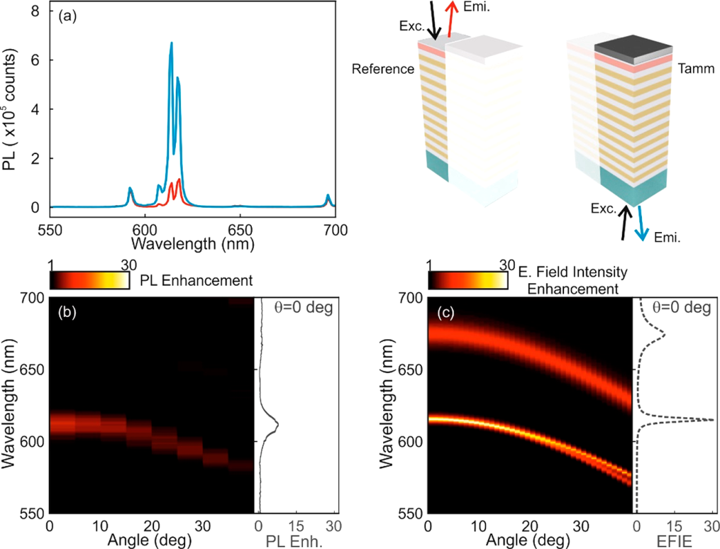
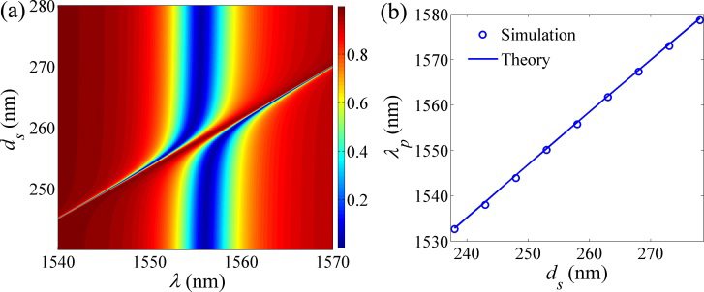
Tamm Plasmon
Induced reflection in Tamm plasmon systems
Tamm Plasmons Directionally Enhance Rare-Earth Nanophosphor Emission
Obvious EIT-like peaks when d_{s} is around 258 nm
Optics Express 27, 5383-5392 (2019)
ACS photonics 8b01407 (2019)

Slide 5
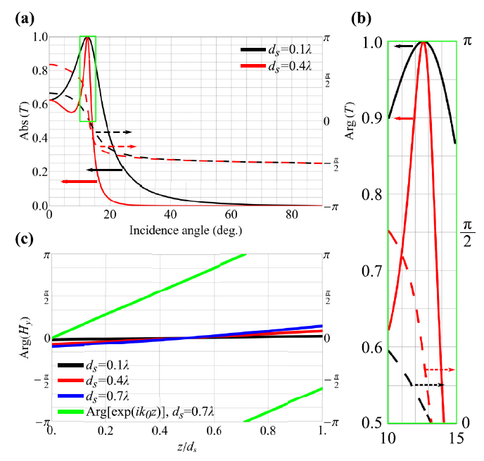
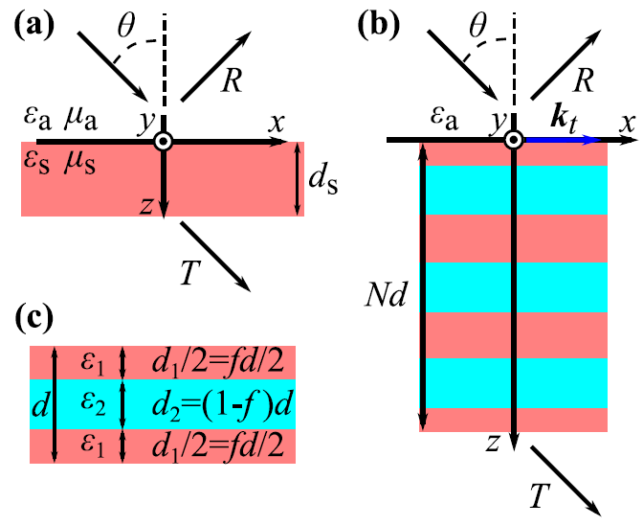
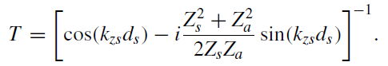
Brewster effect when approaching exceptional points of degeneracy: Epsilon-near-zero behavior
Two conditions for full transmission without phase accumulation:
Z_{s}=Z_{a};
k_{zs}=0. (defines the critical angle θ_{c} of the total internal reflection (TIR))
The Brewster angle and the critical angle of total internal reflection should be close
PHYSICAL REVIEW B 99, 045146 (2019)

Slide 6
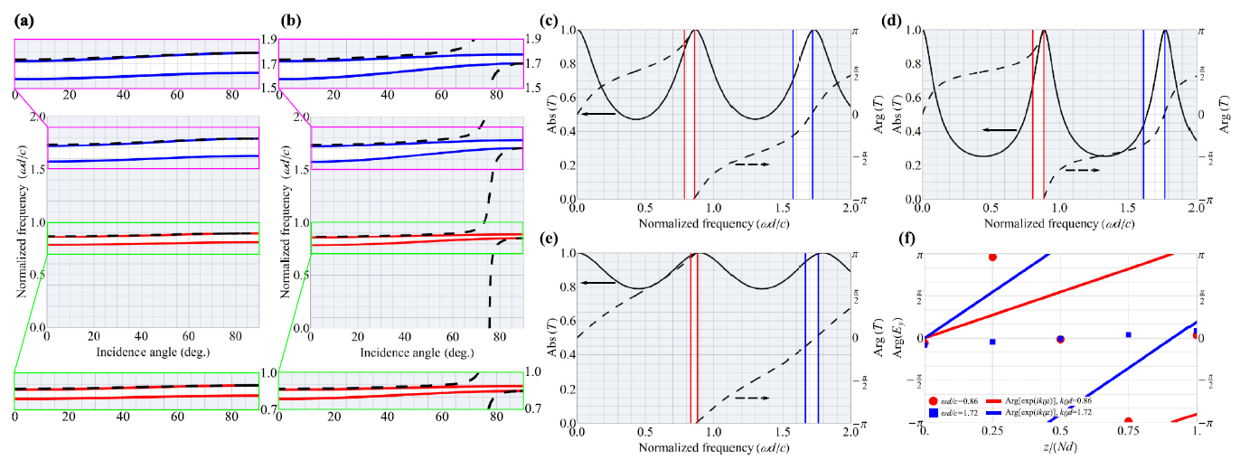
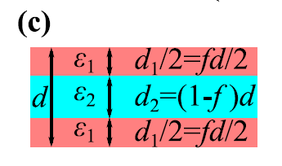
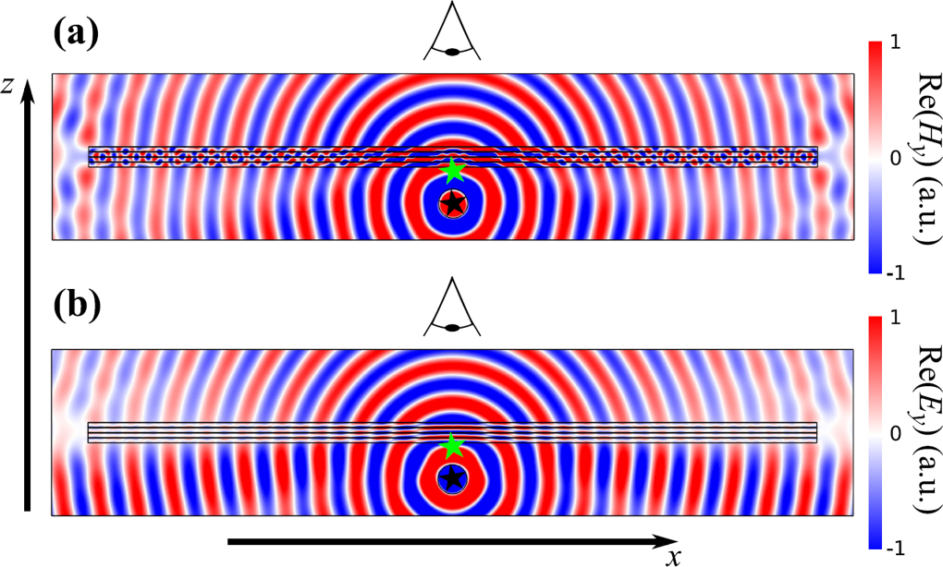
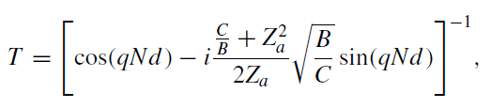
APPLICATION OF A 1D PHOTONIC CRYSTAL
PHYSICAL REVIEW B 99, 045146 (2019)

Slide 7
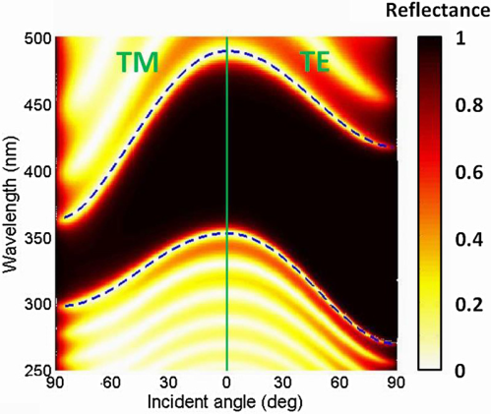
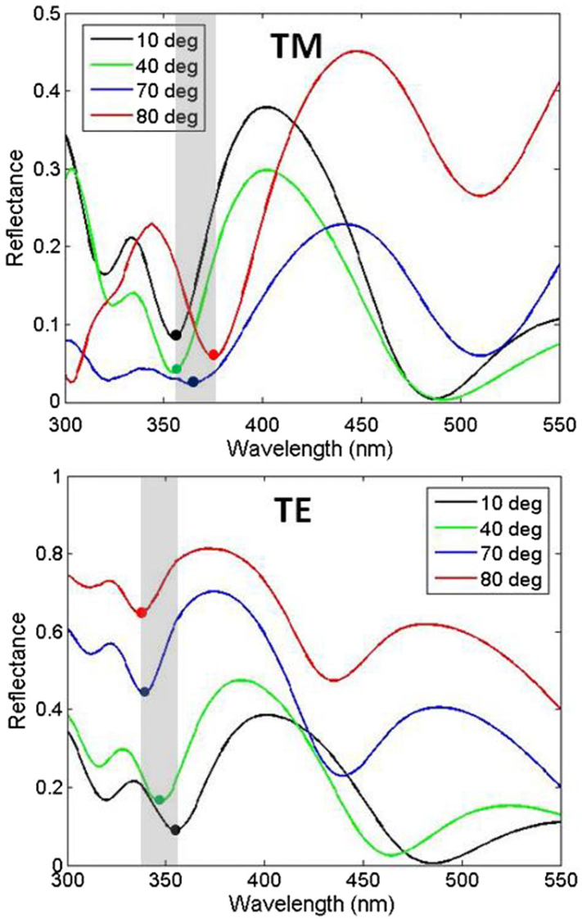
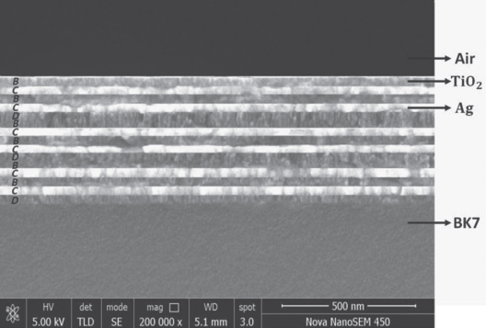
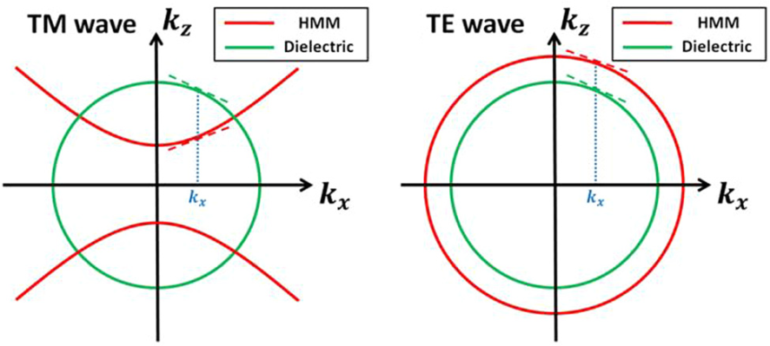
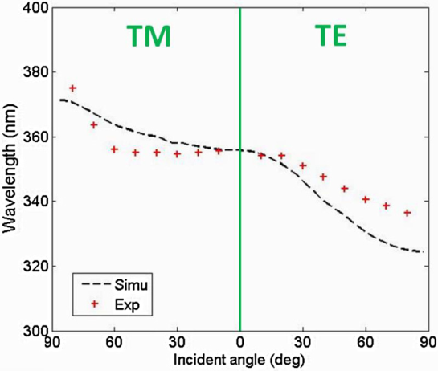
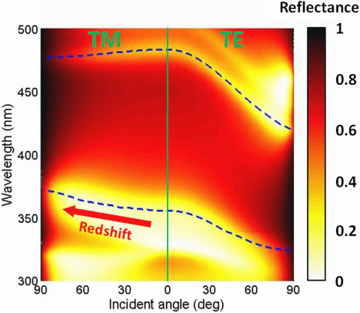
Redshift gaps
Reflection spectrum of (AB)¹⁰ for TM and TE
Measured and simulated short-wavelength gap edges vs incident angle for TM and TE waves
Reflection spectrum of [(CD)²B]³for TM and TE
PHYS. REV. APPLIED 10, 064022 (2018)

Slide 8
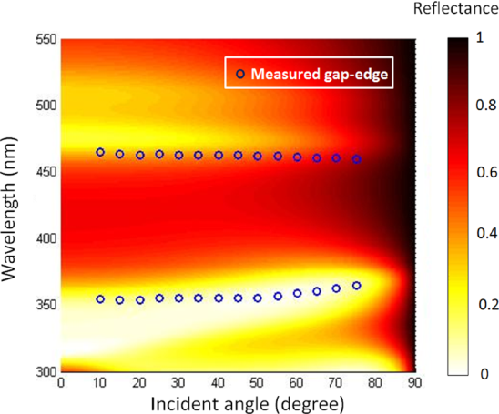
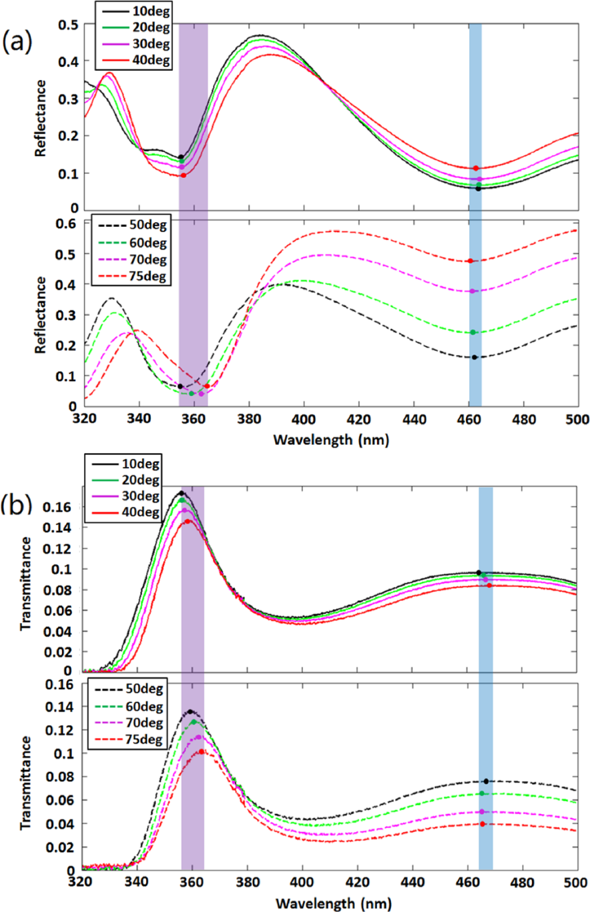
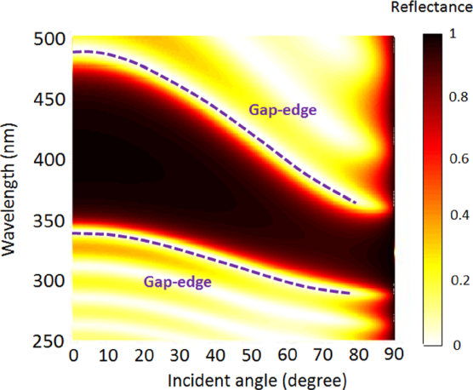
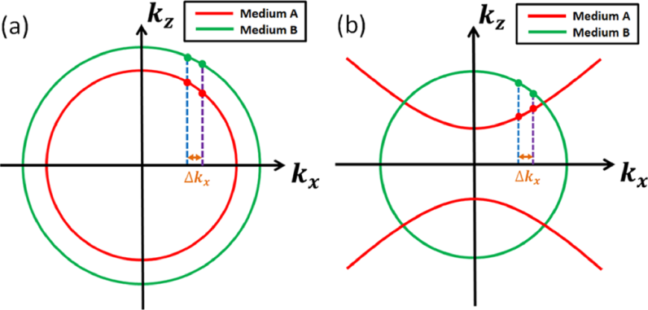
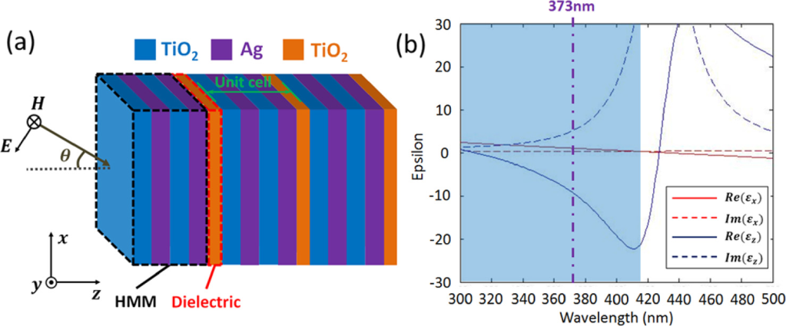
Angle-independent gaps
Appl. Phys. Lett. 112, 041902 (2018)

Slide 9
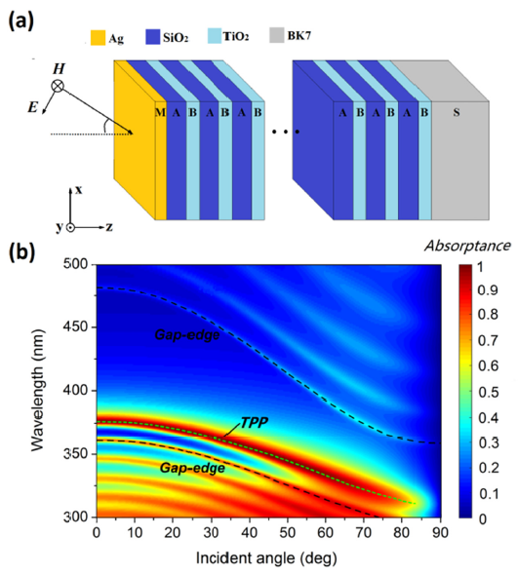
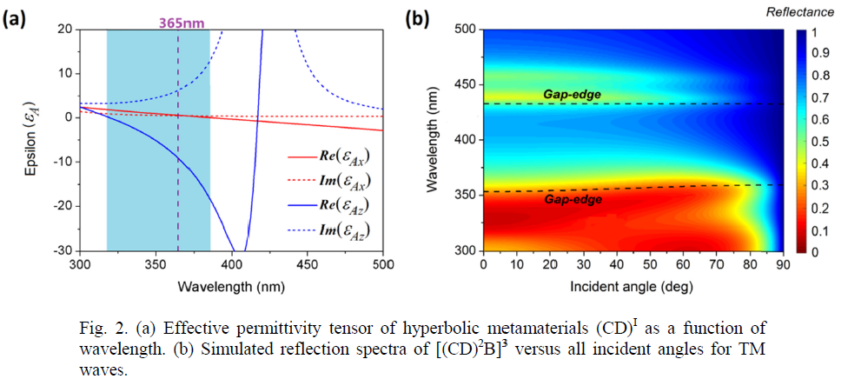
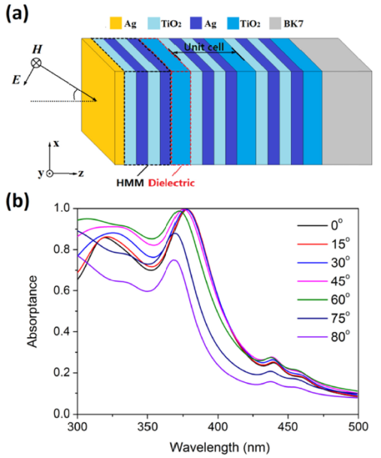

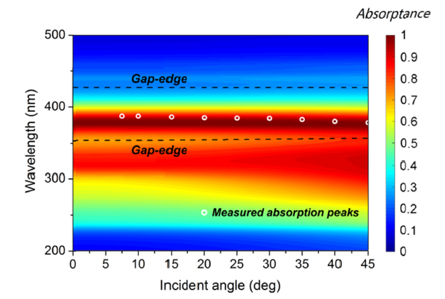
Perfect optical absorbers in a wide range of incidence
Schematic of the heterostructure M(AB)¹⁵
Optics Express 27, 5326-5336 (2019)

Slide 10
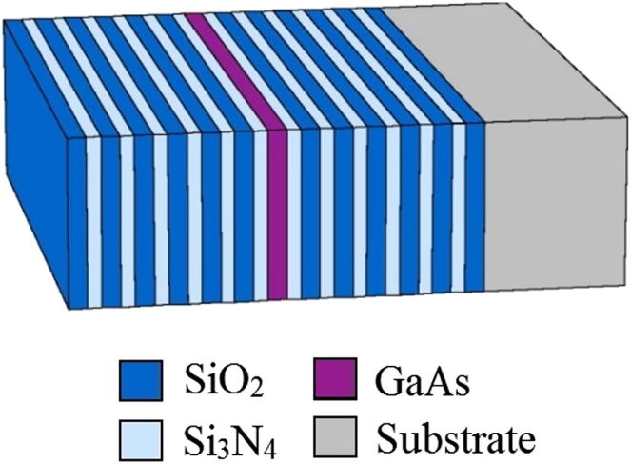
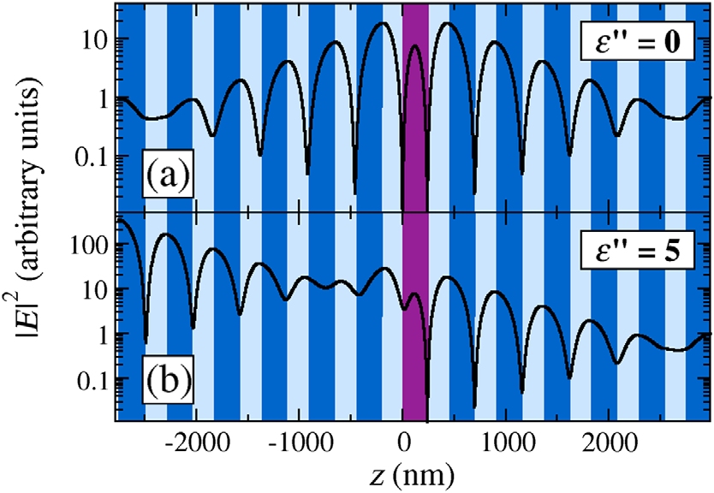
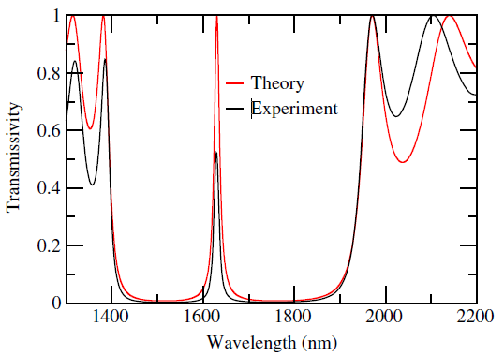
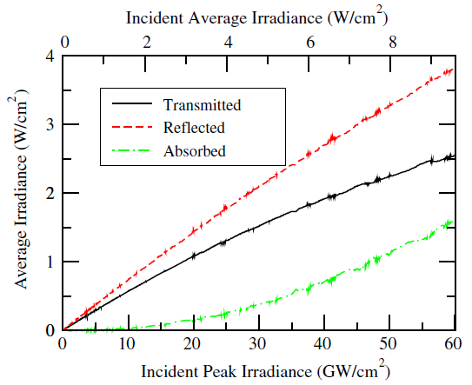
Experimental Realization of a Reflective Optical Limiter
low-intensity irradiance
If the incident light intensity increases, the cavity mode will disappear and the layered structure will become highly reflective within the entire photonic band gap
PHYS. REV. APPLIED 5, 064010 (2016)

Slide 11
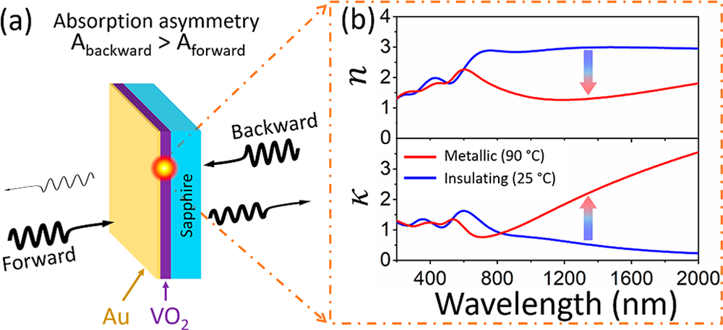
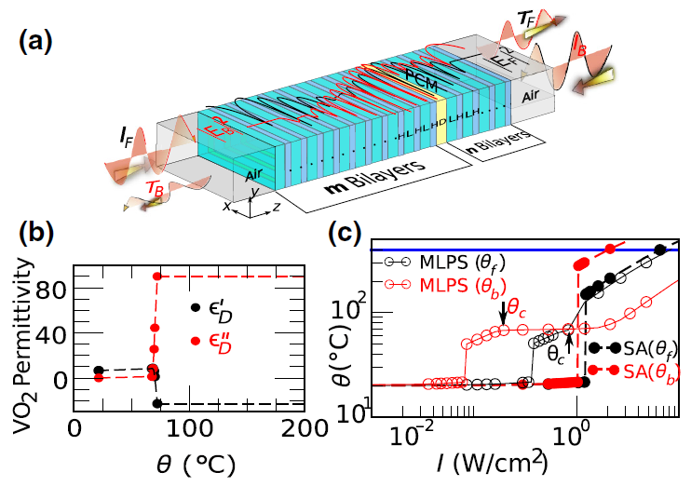
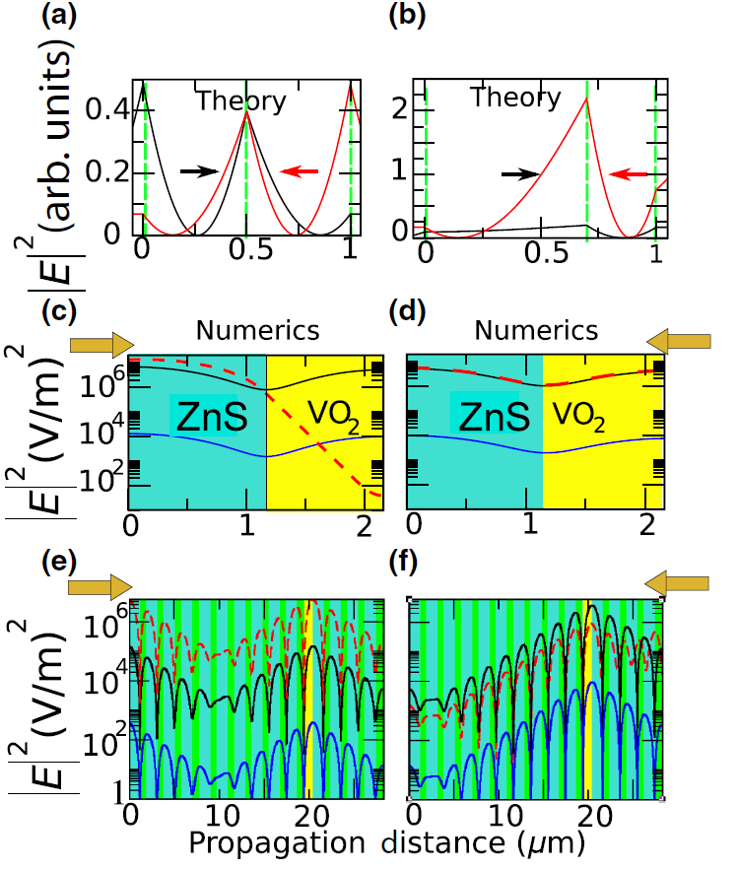
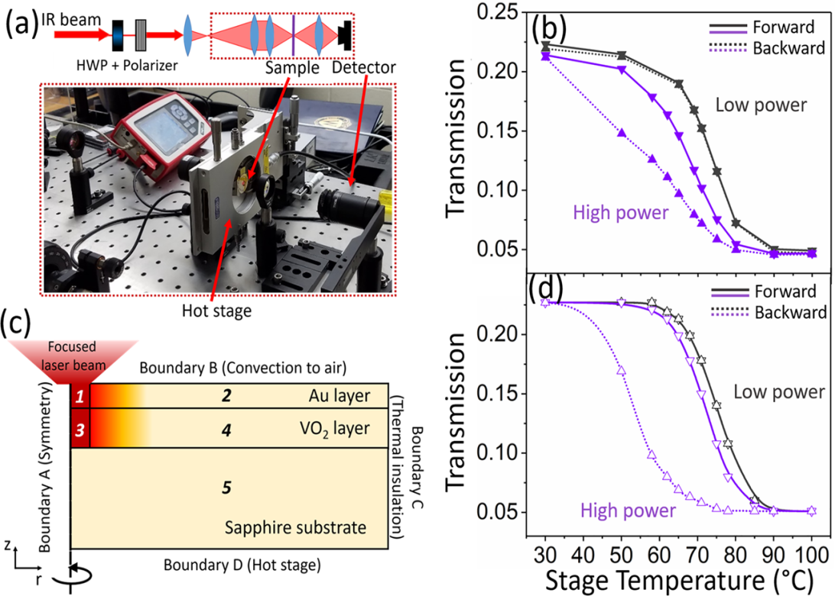
Limiting Optical Diodes and Nonreciprocity
ACS Photonics 5, 2688−2692 (2018)
PHYS. REV. APPLIED 11, 024046 (2019)
Notes:
The solid blue, black,and dashed red curves denote varying incident irradiances of
2.656×10−5 (blue), 1.06×10−2 (black), and 0.39 (red) W/cm2.

Slide 12
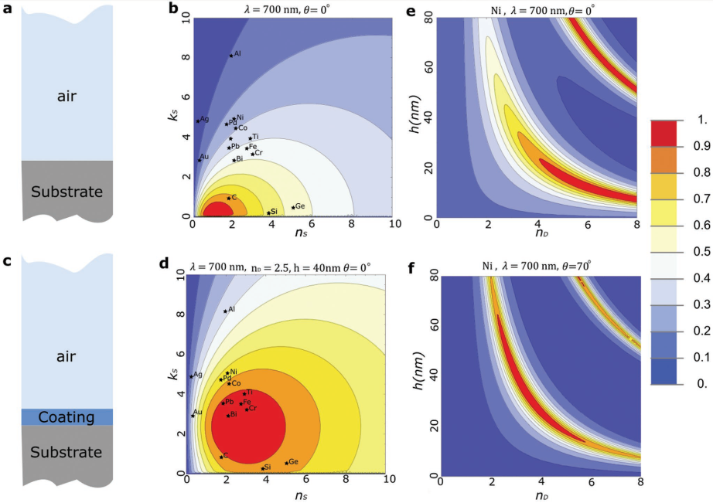
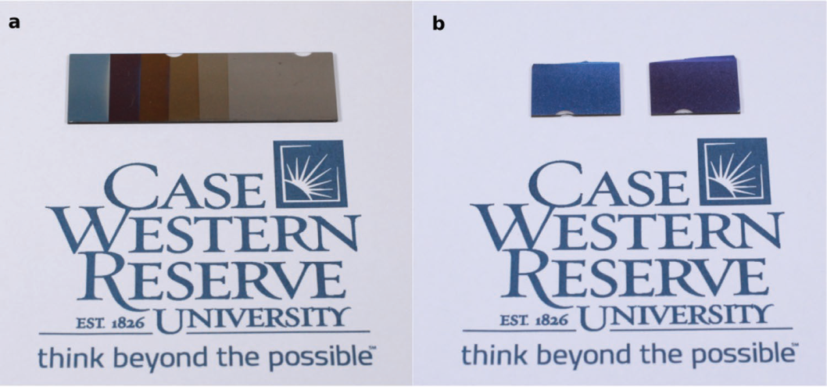
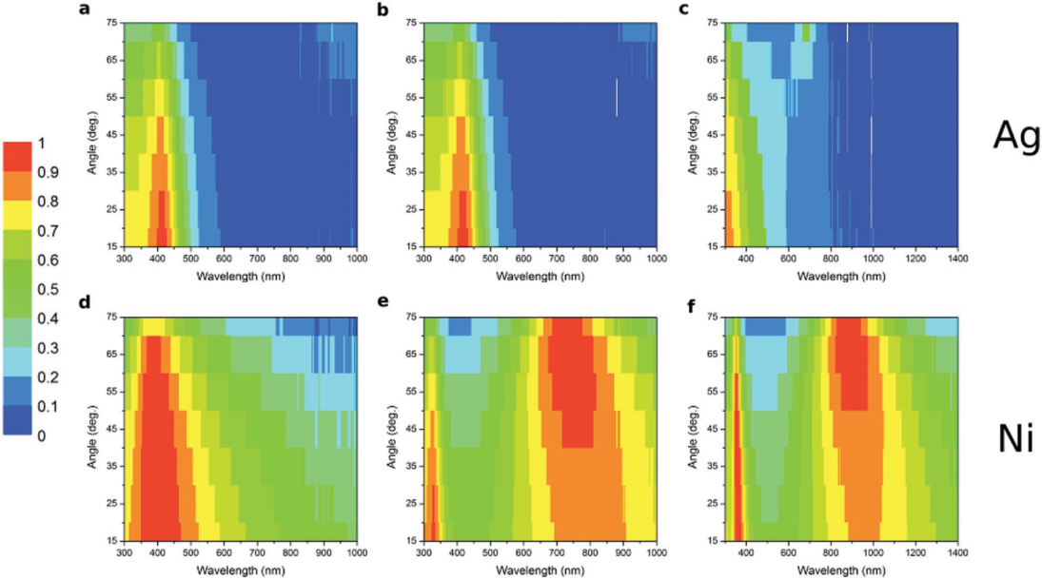
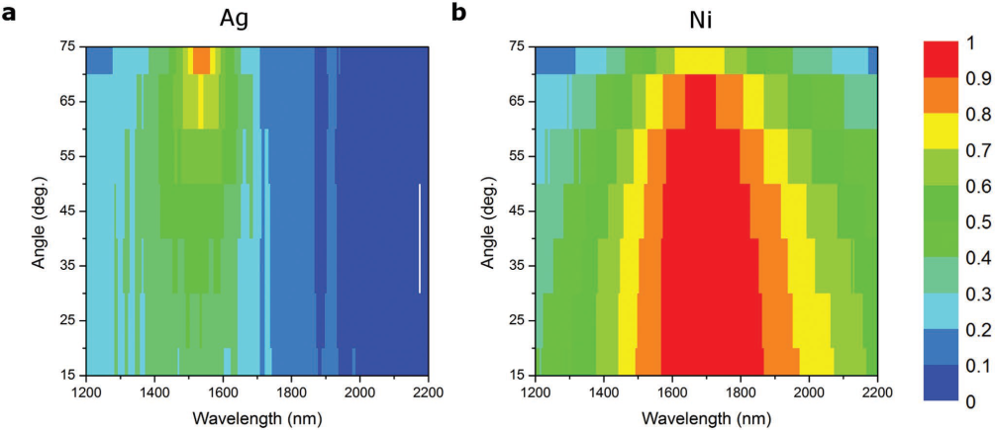
Designer Perfect Light Absorption Using Ultrathin Lossless
Dielectrics on Absorptive Substrates
TiO2 with different thicknesses deposited on an opaque Ni substrate for a) a smooth glass substrate and b) frosted glass substrate
The absorptivity of an 80 nm thick Ge layer is deposited on a) Ag and b) Ni substrates
Coated TiO₂ with thicknesses a,d) 18 nm, b,e) 60 nm, c,f) 86 nm
Adv. Optical Mater. 1800672 (2018)

Slide 13
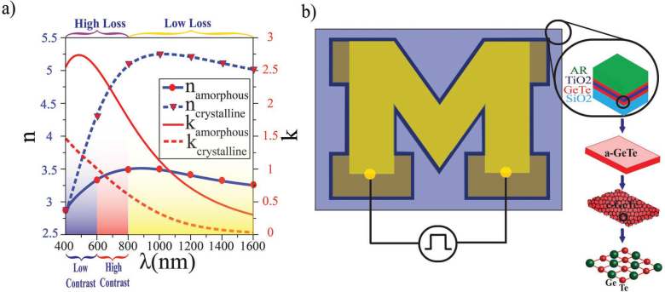
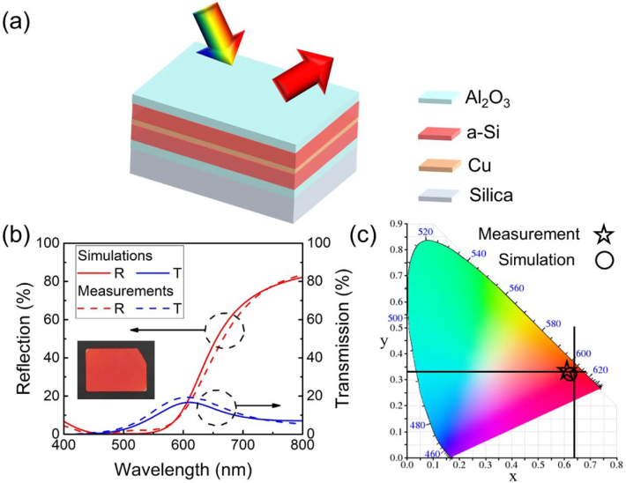

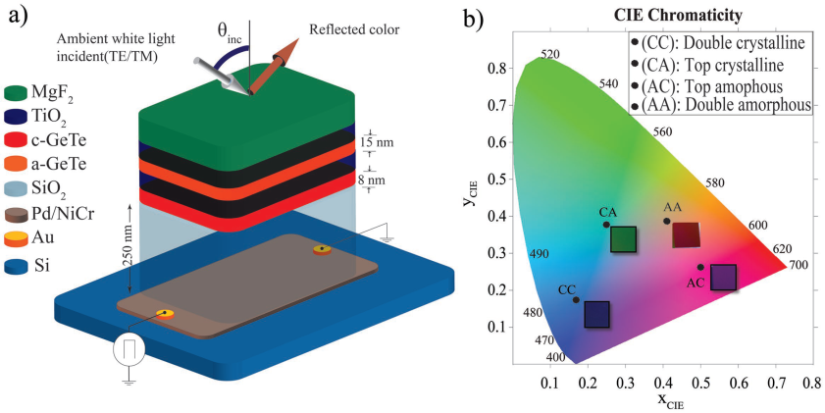
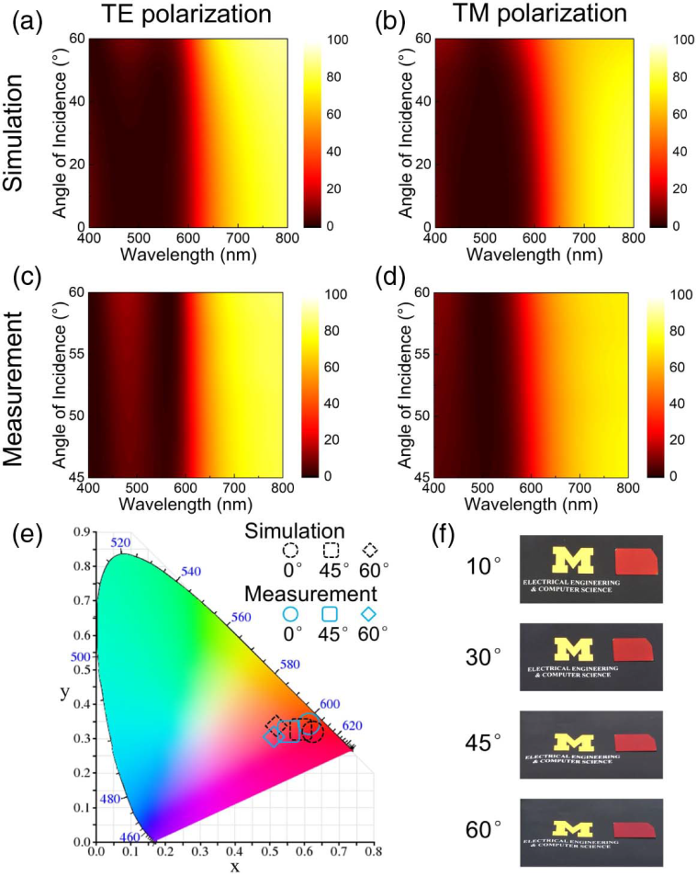
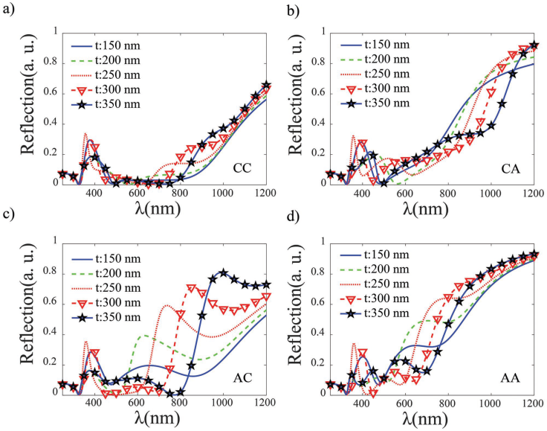
Color Reflector
High-color-purity, angle-invariant
Adv. Optical Mater. 1801214 (2018)
Optics Letters 44, 86-89 (2019)

Slide 14
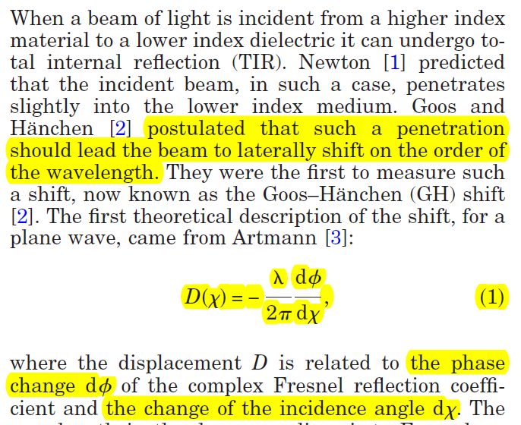
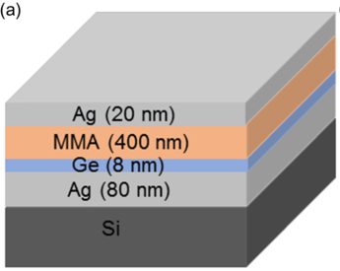





Giant enhancement in Goos-Hänchen shift at
the singular phase of a nanophotonic cavity
Optics Letters 33, 794-796 (2008)
PHYSICAL REVIEW A 92, 013815 (2015)
Appl. Phys. Lett. 112, 161109 (2018)

Slide 15





Absorber Cavities and Biosensing application
Adv. Mater. 1706696 (2018)
NATURE COMMUNICATIONS 9, 369 (2018)

Slide 16






Extension
Label-Free Optical Biosensors
Giant Goos-Hänchen shift induced by bounded states in optical PT-symmetric bilayer structures
Adv. Optical Mater. 1801313 (2019)
Optics Express 27, 7857-7867 (2019)

Slide 17




Dual-band infrared imaging
Design and working principle of
HgTe CQDs dual-band detectors
Spectral response of the dual-band detector at 85 K
SWIR/MWIR dual-band imaging
Tang, Xin, et al. "Dual-band infrared imaging using stacked colloidal quantum dot photodiodes." Nature Photonics (2019): 1.

Slide 18






Bianisotropic Photonic Metamaterials
IEEE journal of selected topics in quantum electronics 16, 367-375 (2010)

Slide 19







Retrieving effective parameters by nonlocal relations
PHYSICAL REVIEW B 99, 035442 (2019)

